Slide 1
Chapter 7
Laplace Transforms

Slide 2
Applications of Laplace Transform
Easier than solving differential equations
  Used to describe system behavior
  We assume LTI systems
  Uses S-domain instead of frequency domain
Applications of Laplace Transforms/
  Circuit analysis
    Easier than solving differential equations
    Provides the general solution to any arbitrary wave (not just LRC)
      Transient
      Sinusoidal steady-state-response (Phasors)
  Signal processing
  Communications
Definitely useful for Interviews!
notes

Slide 3
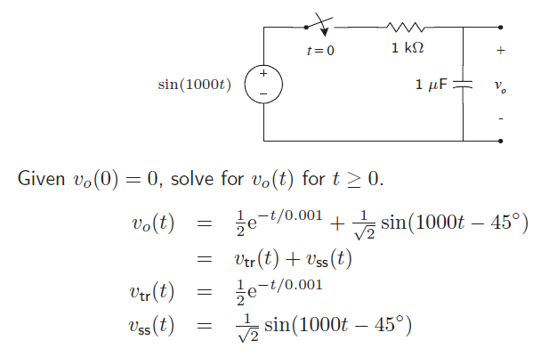
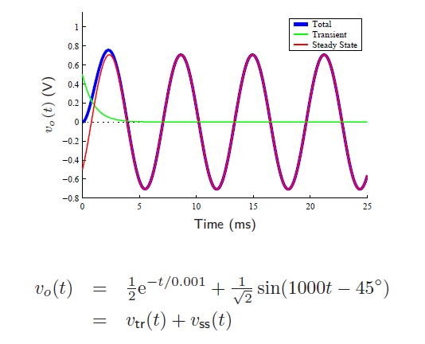
Building the Case…
http://web.cecs.pdx.edu/~ece2xx/ECE222/Slides/LaplaceTransformx4.pdf

Slide 4
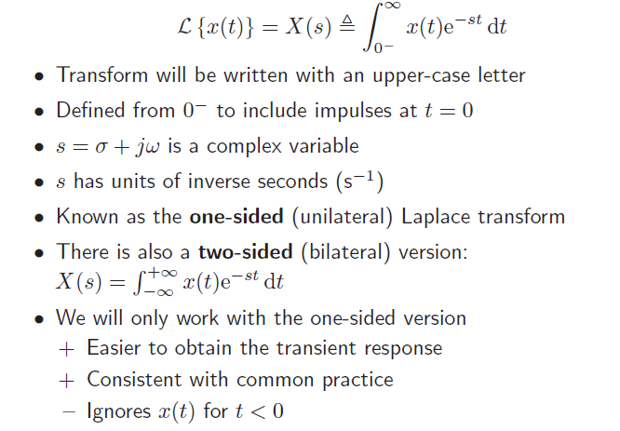
Laplace Transform

Slide 5
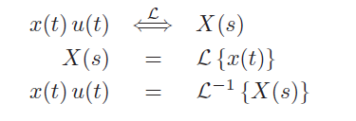
Laplace Transform
We use the following notations for Laplace Transform pairs – Refer to the table!

Slide 6
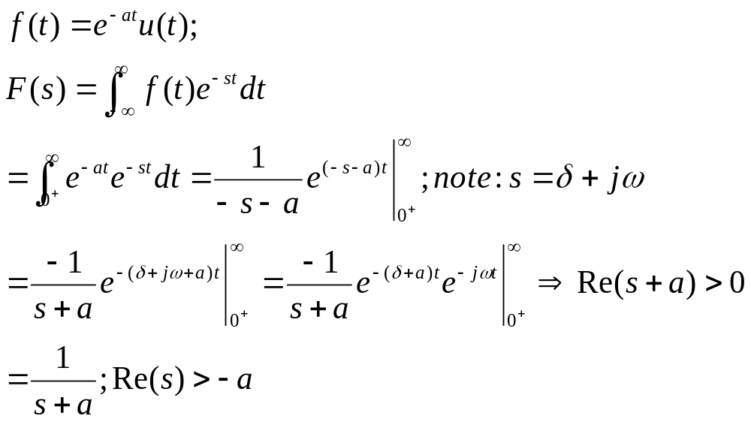
Laplace Transform Convergence
The Laplace transform does not converge to a finite value for all signals and all values of s
The values of s for which Laplace transform converges is called the Region Of Convergence (ROC)
Always include ROC in your solution!
Example:
0+ indicates greater than zero values
Remember: e^jw is sinusoidal; Thus, only the real part is important!

Slide 7
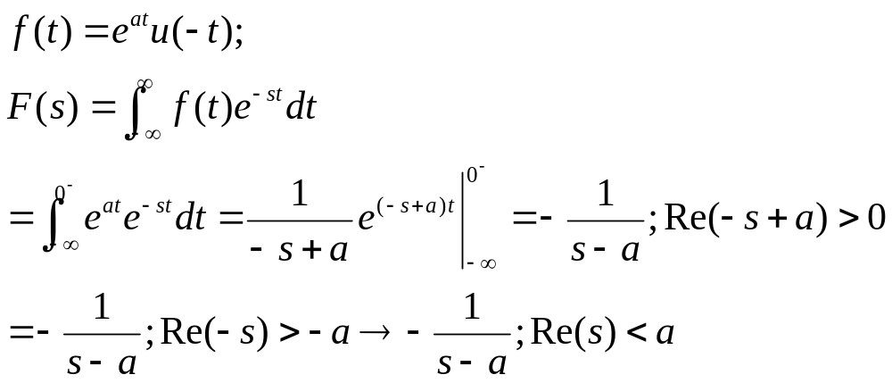
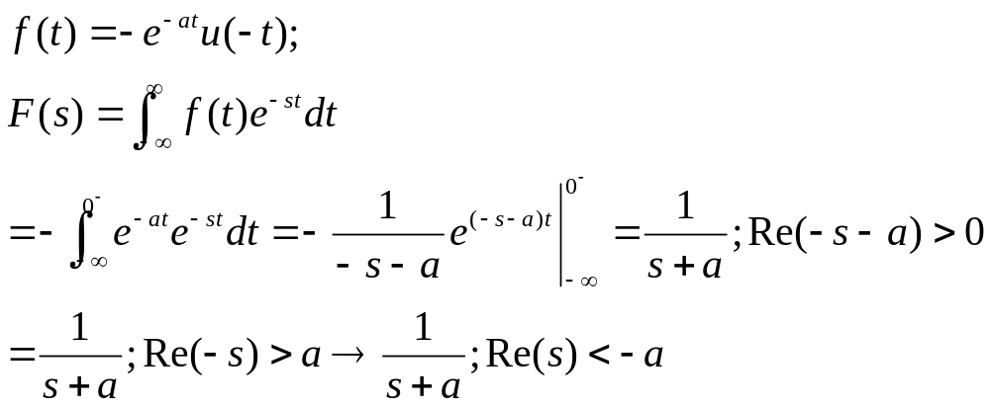
Example of Bilateral Version
Find F(s):
ROC
S-plane
Re(s)<a
a
Find F(s):
Remember
These!
Note that Laplace can also be found for periodic functions

Slide 8
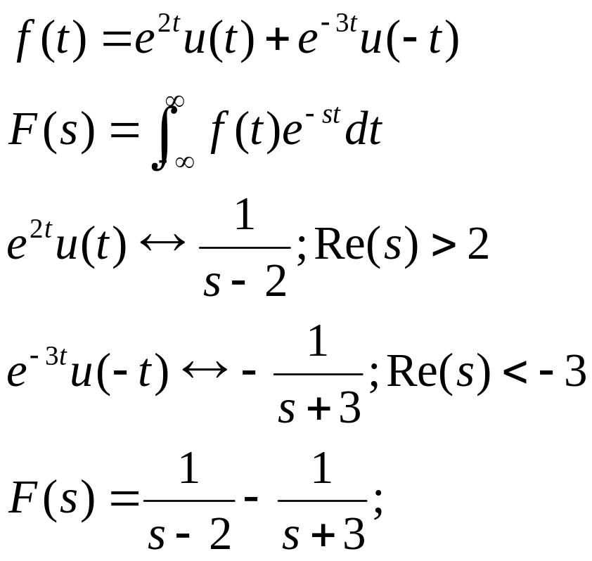
Example – RCO may not always exist!
Note that there is no common ROC → Laplace Transform can not be applied!

Slide 9
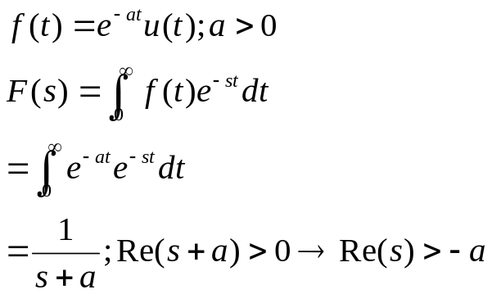
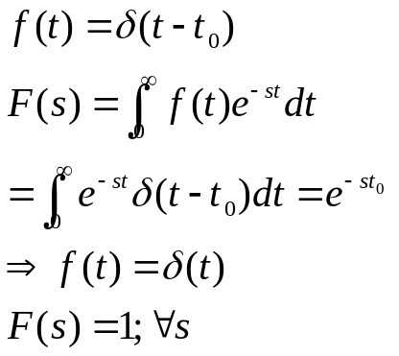
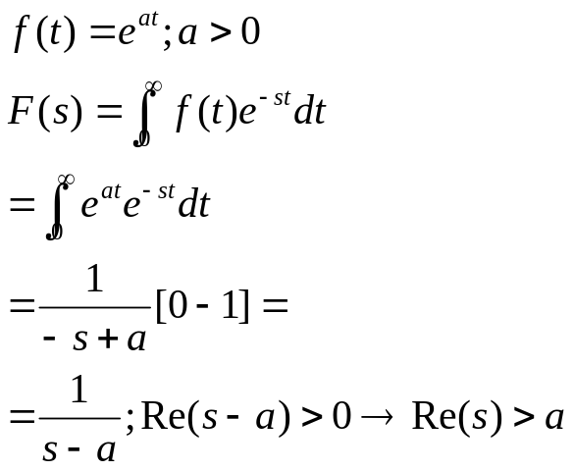
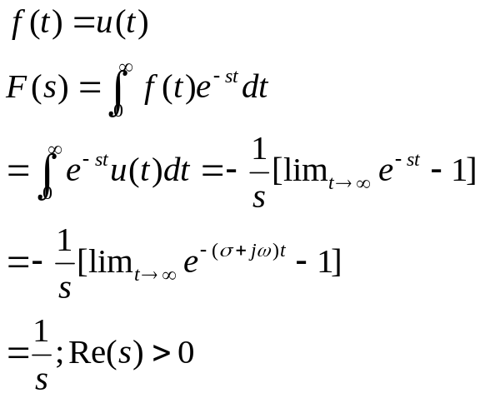
Example – Unilateral Version
Find F(s):
Find F(s):
Find F(s):
Find F(s):

Slide 10
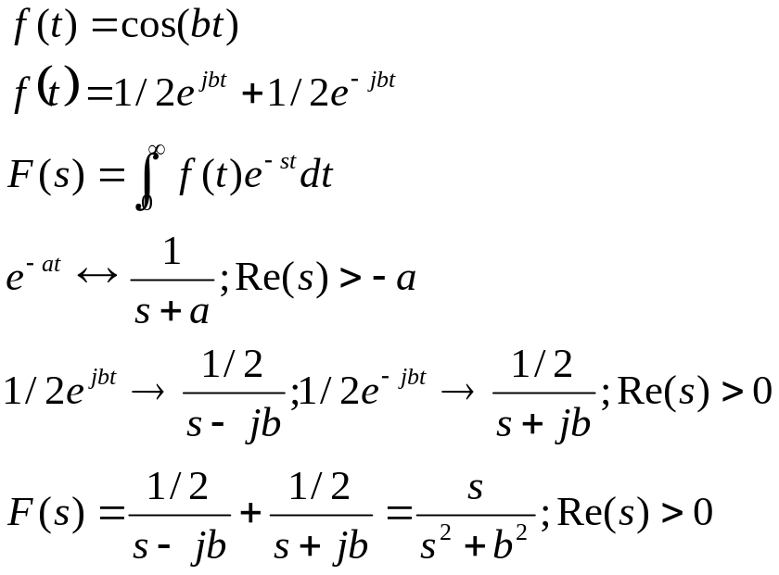
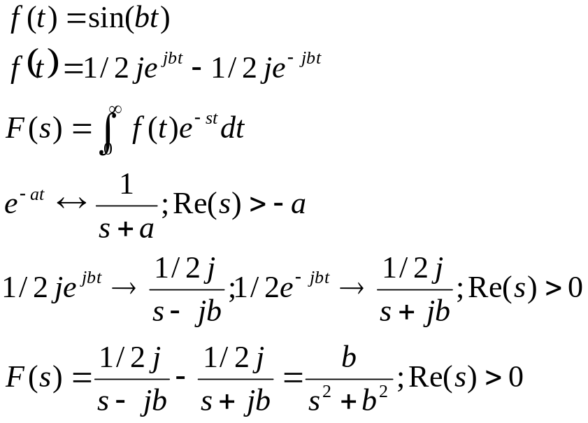
Example

Slide 11
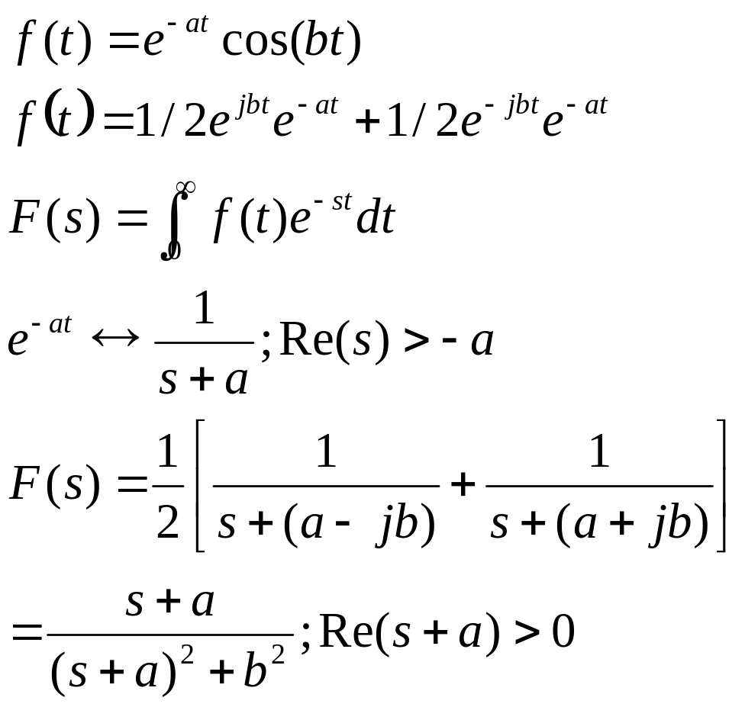
Example

Slide 12
Properties
The Laplace Transform has many difference properties
Refer to the table for these properties

Slide 13
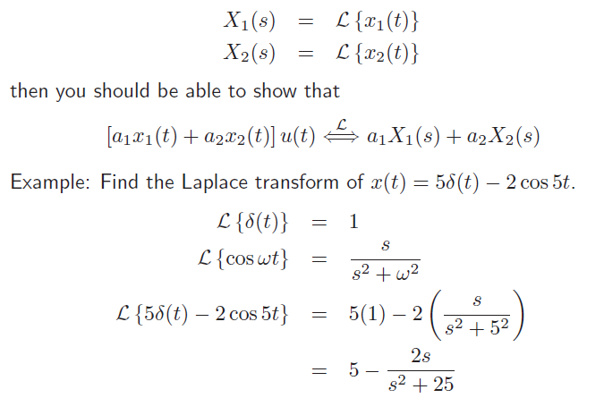
Linearity

Slide 14
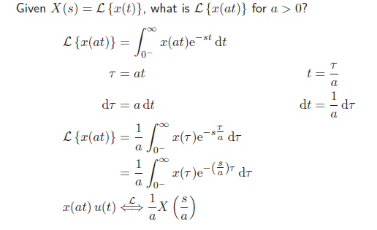
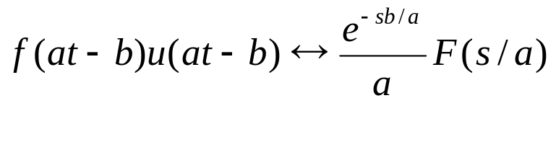
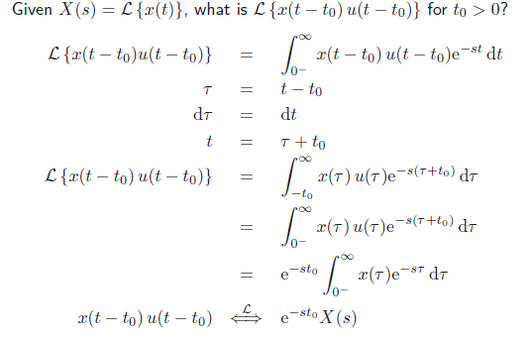
Scaling & Time Translation
Scaling
Do the time translation first!
Time Translation
b=0

Slide 15
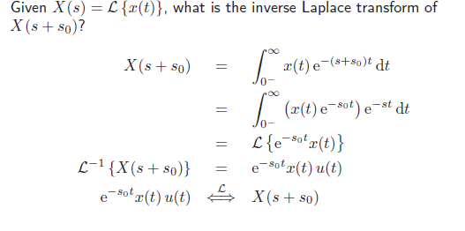
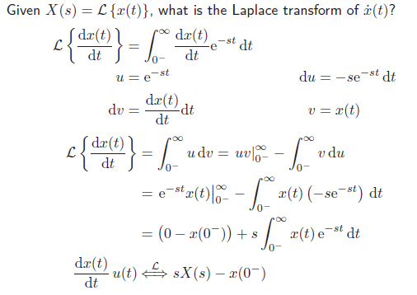
Shifting and Time Differentiation
Shifting in s-domain
Differentiation in t
Read the rest of properties on your own!

Slide 16
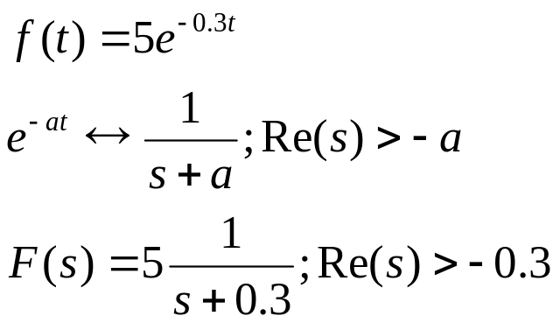
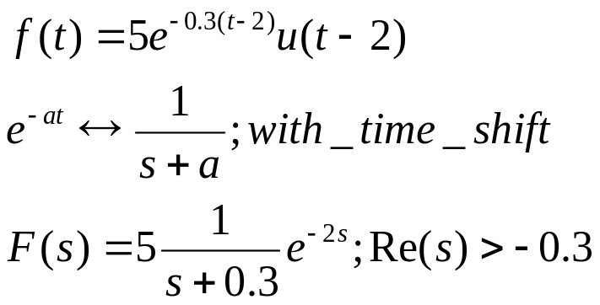
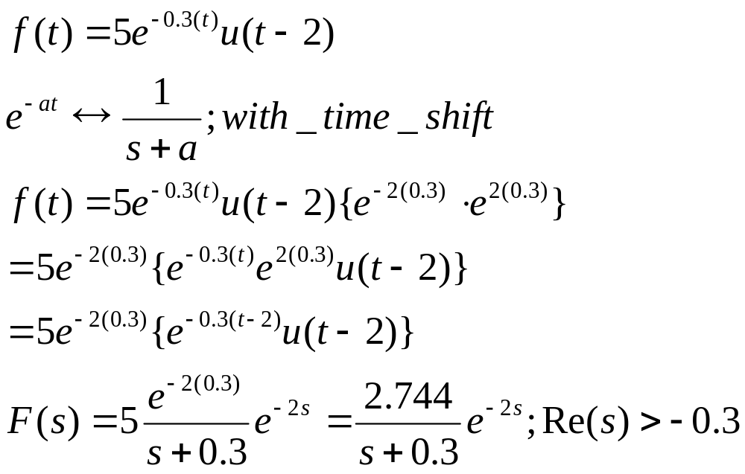
Examples
Note the ROC did not change!

Slide 17
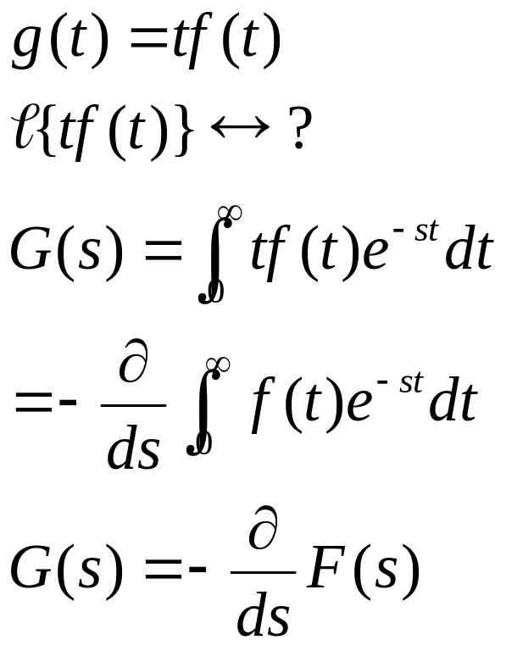
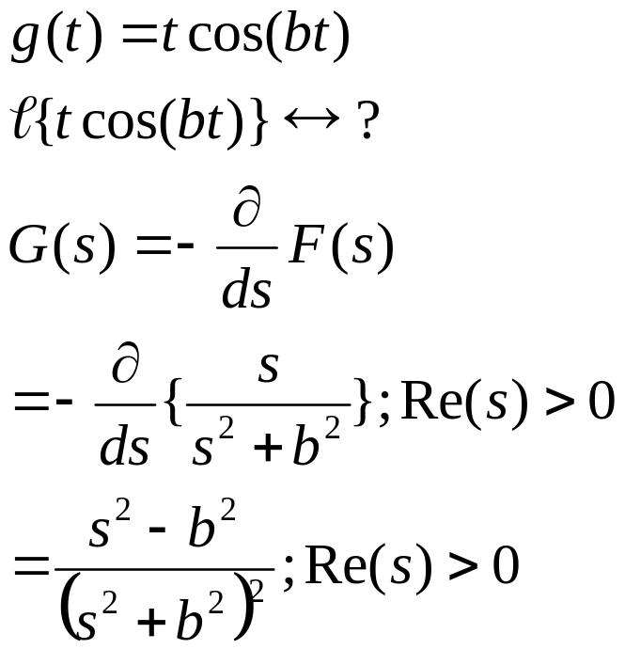
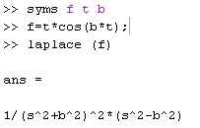
Example – Application of Differentiation
Matlab Code:
Read Section 7.4
Read about Symbolic Mathematics:
http://www.math.duke.edu/education/ccp/materials/diffeq/mlabtutor/mlabtut7.html
And
http://www.mathworks.de/access/helpdesk/help/toolbox/symbolic/ilaplace.html

Slide 18
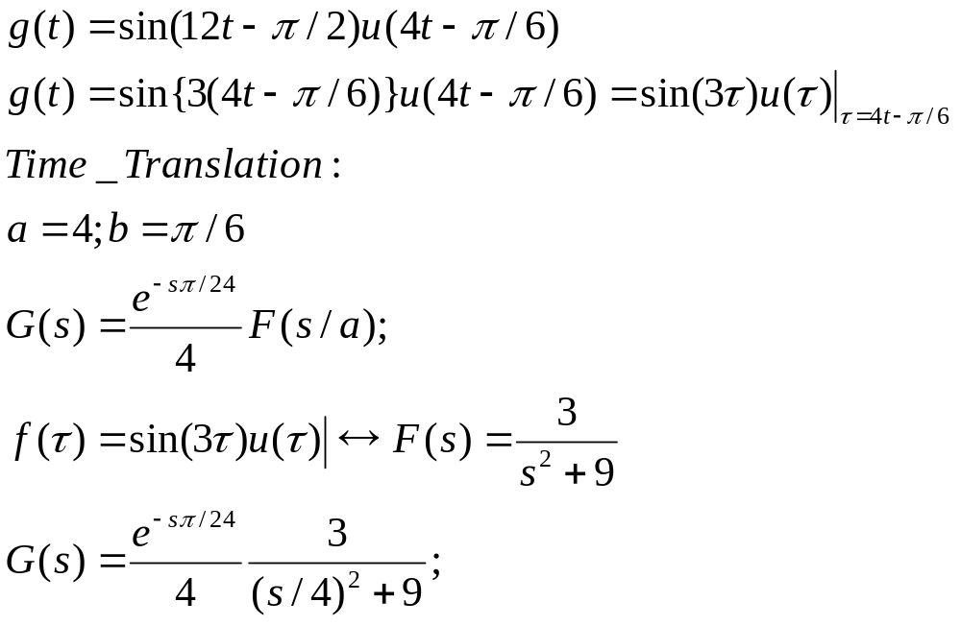
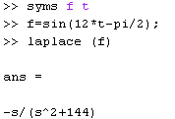
Example
What is Laplace of t^3?
  From the table: 3!/s^4 Re(s)>0
Find the Laplace Transform:
Time transformation
Note that without u(.) there will be no time translation and thus, the result will be different:
Assume t>0

Slide 19







A little about Polynomials
Given Laplace find f(t)!
Consider a polynomial function:
A rational function is the ratio of two polynomials:
A rational function can be expressed as partial fractions
A rational function can be expressed using polynomials presented in product-of-sums
Has roots and zeros; distinct roots, repeated roots, complex roots, etc.

Slide 20

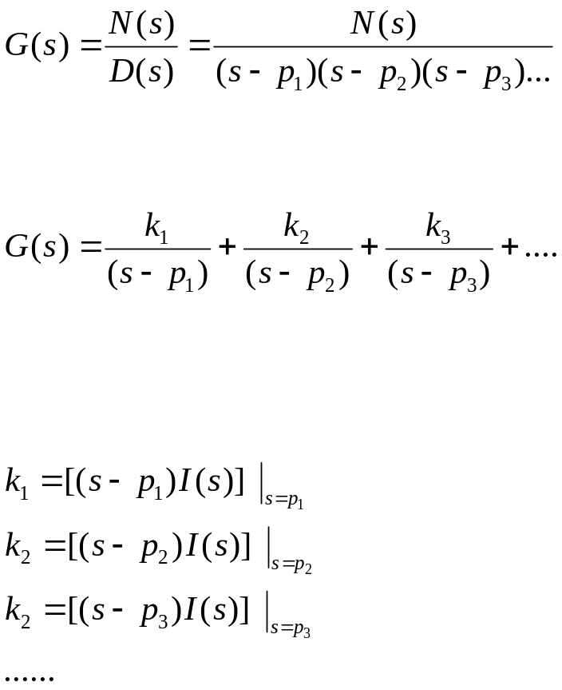
Finding Partial Fraction Expansion
Given a polynomial
Find the POS
(product-of-sums) for the denominator:
Write the
partial fraction expression
for the polynomial
Find the constants
  If the rational polynomial has
  distinct poles then we can use the
  following to find the constants:
http://cnx.org/content/m2111/latest/

Slide 21

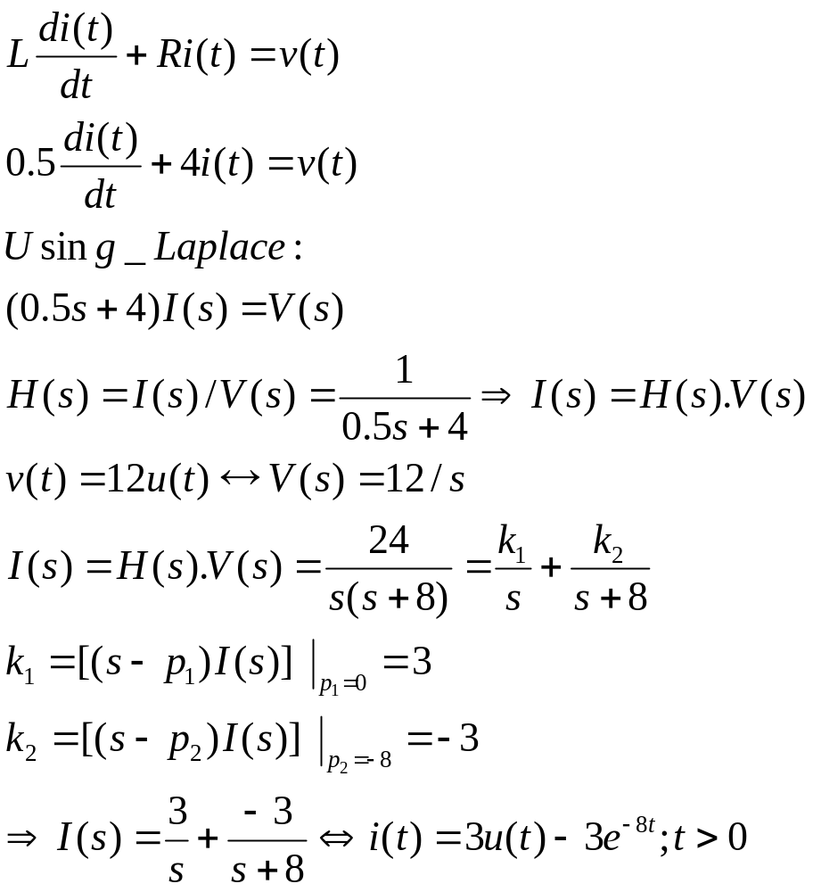



Application of Laplace
Consider an RL circuit with R=4, L=1/2. Find i(t) if v(t)=12u(t).
Matlab
Code
Given
Partial fraction expression

Slide 22
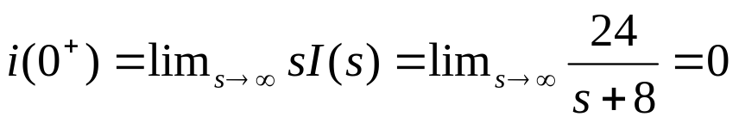
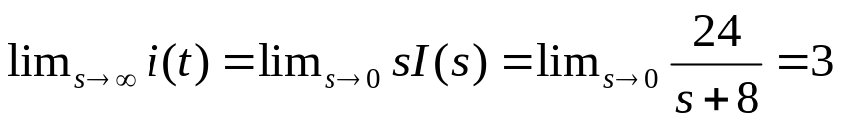
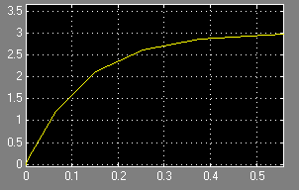
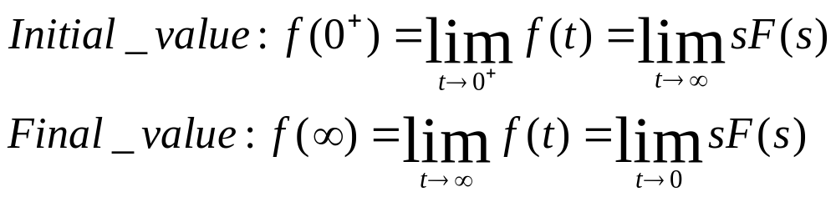

Application of Laplace
What are the initial [i(0)] and final values:
  Using initial-value property:
  Using the final-value property
Note that
Initial Value: t=0, then, i(t) →3-3=0
Final Value: t→ INF then, i(t) →3
Note: using Laplace Properties

Slide 23
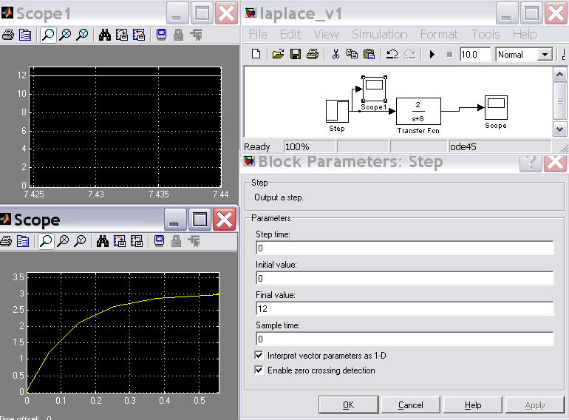
Using Simulink
v(t)
H(s)
i(t)

Slide 24
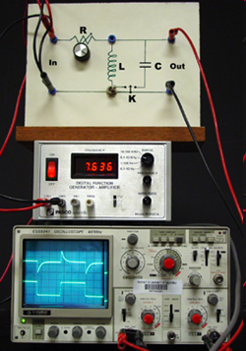
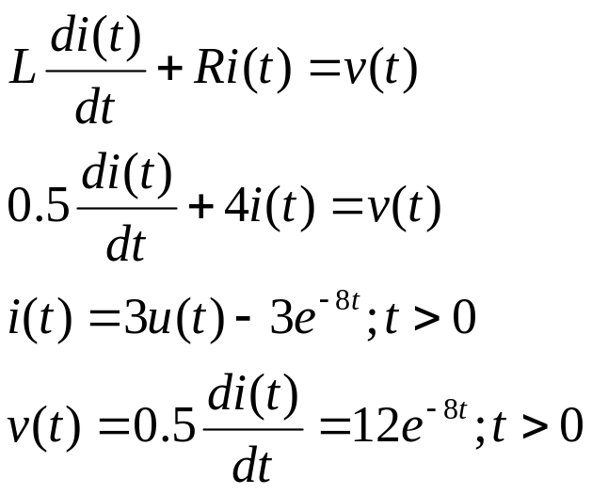
Actual Experimentation
Note how the voltage looks like:
Output Voltage:
Input Voltage:

Slide 25



Partial Fraction Expansion
(no repeated Poles/Roots) – Example
Using Matlab:
Matlab code:
  b=[8 3 -21];
  a=[1 0 -7 -6];
  [r,p,k]=residue(b,a)
We can also use ilaplace (F); but the result may not be simplified!

Slide 26
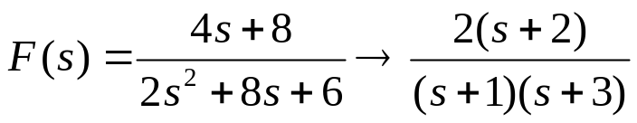
Finding Poles and Zeros
Express the rational function as the ratio of two polynomials each represented by product-of-sums
Example:
Pole
S-plane
zero

Slide 27
H(s) Replacing the Impulse Response
x(t)
h(t)
y(t)
X(s)
H(s)
Y(s)
convolution
multiplication

Slide 28
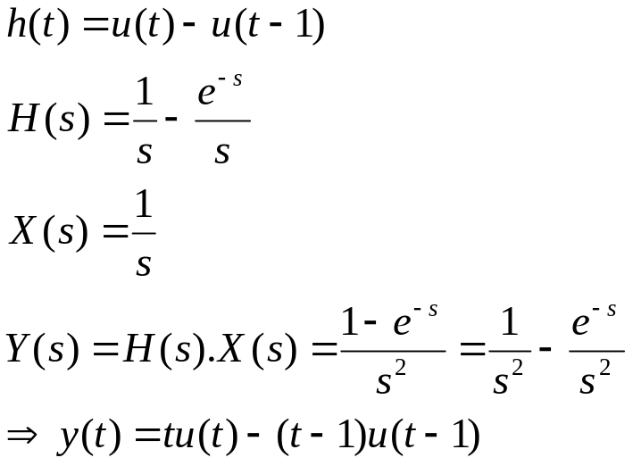
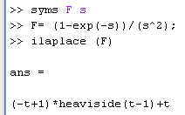
H(s) Replacing the Impulse Response
x(t)
h(t)
y(t)
X(s)
H(s)
Y(s)
convolution
multiplication
Example: Find the output
X(t)=u(t); h(t)
1
h(t)
0
1
e^-sF(s)
1
y(t)
0
1
This is commonly used in D/A converters!

Slide 29


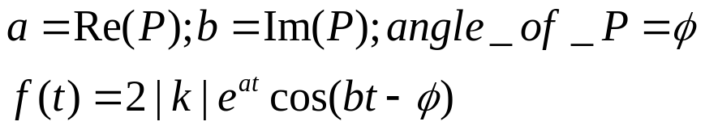
Dealing with Complex Poles
Given a polynomial
Find the POS (product-of-sums) for the denominator:
Write the partial fraction expression for the polynomial
Find the constants
  The pole will have a real and imaginary part: P=|k|φ
When we have complex poles {|k|φ} then we can use the following expression to find the time domain expression:
http://cnx.org/content/m2111/latest/

Slide 30
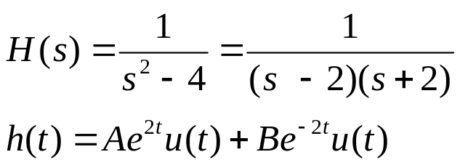
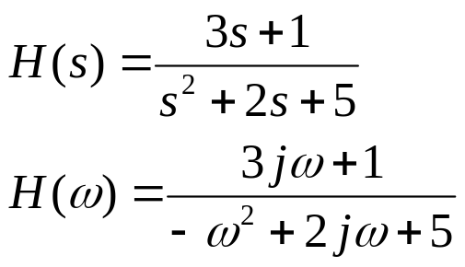
Laplace Transform Characteristics
Assumptions: Linear Continuous Time Invariant Systems
Causality
  No future dependency
  If unilateral: No value for t<0; h(t)=0
Stability
  System mode: stable or unstable
  We can tell by finding the system characteristic equation (denominator)
    Stable if all the poles are on the left plane
  Bounded-input-bounded-output (BIBO)
Invertability
  H(s).Hi(s)=1
Frequency Response
  H(w)=H(s);s→jw=H(s=jw)
We need to add control mechanism to make the overall system stable

Slide 31
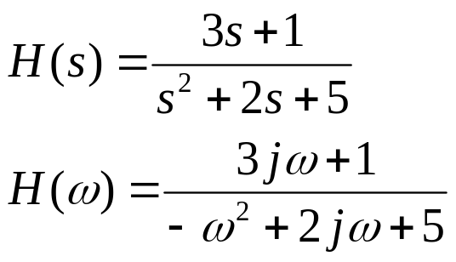

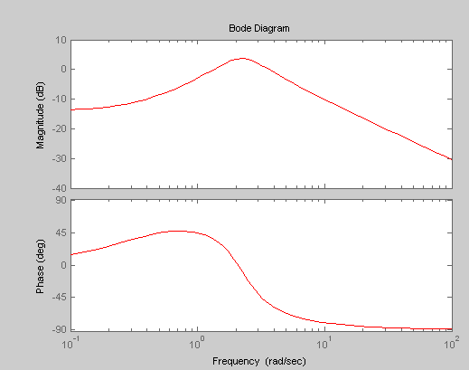
Frequency Response – Matlab Code

Slide 32
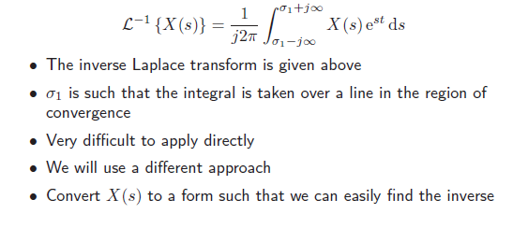
Inverse Laplace Transform

Slide 33
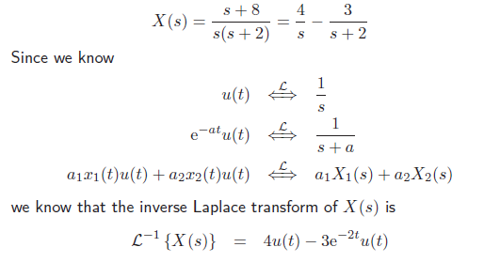
Example of Inverse Laplace Transform

Slide 34
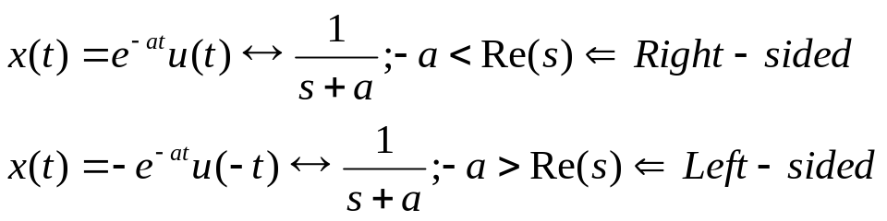
Bilateral Transforms
Laplace Transform of two different signals can be the same, however, their ROC can be different:
→ Very important to know the ROC.
Signals can be
  Right-sided → Use the bilateral Laplace Transform Table
  Left-sides
  Have finite duration
How to find the transform of signals that are bilateral!
See notes

Slide 35
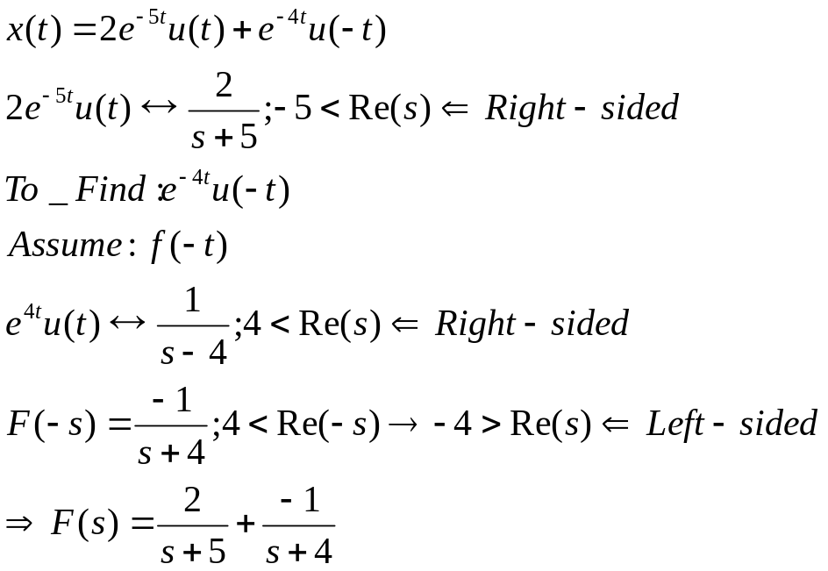


How to Find Bilateral Transforms
If right-sided use the table for unilateral Laplace Transform
Given f(t) left-sided; find F(s):
  Find the unilateral Laplace transform for f(-t)→ laplace{f(-t)}; Re(s)>a
  Then, find F(-s) with Re(-s)>a
Given Fb(s) find f(t) left-sided :
  Find the unilateral Inverse Laplace transform for F(s)=f_{b}(t)
  The result will be f(t)=–f_{b}(t)u(-t)
Example

Slide 36

Examples of Bilateral Laplace Transform
  Find the unilateral Laplace transform for f(-t)→ laplace{f(-t)}; Re(s)>a
  Then find F(-s) with Re(-s)>a
  Alternatively: Find the unilateral Laplace transform for f(t)u(-t)→
  (-1)laplace{f(t)}; then, change the inequality for ROC.

Slide 37

Feedback System
Find the system function for the following feedback system:
F(s)
X(t)
+
Sum
e(t)
y(t)
+
r(t)
G(s)
Equivalent System
H(s)
X(t)
y(t)
Feedback Applet: http://physioweb.uvm.edu/homeostasis/simple.htm

Slide 38
Practices Problems
Schaum’s Outlines Chapter 3
  3.1, 3.3, 3.5, 3.6, 3.7-3.16, ← For Quiz!
  3.17-3.23
  Read section 7.8
  Read examples 7.15 and 7.16
Useful Applet: http://jhu.edu/signals/explore/index.html

